Slide 1
Introduction of chrome extension development
17/12/2021

Slide 2


Agenda
What is chrome extension?
Why build a chrome extension?
How to build a chrome extension?
Package and deploy chrome extension

Slide 3

I. What is chrome extension?
• Applications, plugin that run inside the Chrome browser and provide additional functionality, and customized browsing experience.
• It's an app within your browse
• Chrome extensions are built the same way web pages are built: HTML, CSS, JavaScript.
- Installs easily
- Update automatically
- Runs in a separate process

Slide 4
I. Why build a chrome extension?
• Chrome — most popular browser
• Integration with Chrome
• Could Extend Chrome & any web site
• Standard Web Stack (JS, HTML, CSS)

Slide 5
I. What do chrome extension do?
Enhance browsing experience by:
• Adding functionality to your Browser
• Giving better UI/UX experience
• Make a long process shorter

Slide 6

I. How to build a chrome extension?

Slide 7
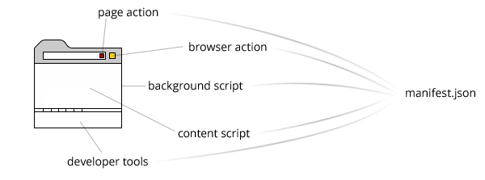
I. How to build a chrome extension?
Architecture

Slide 8
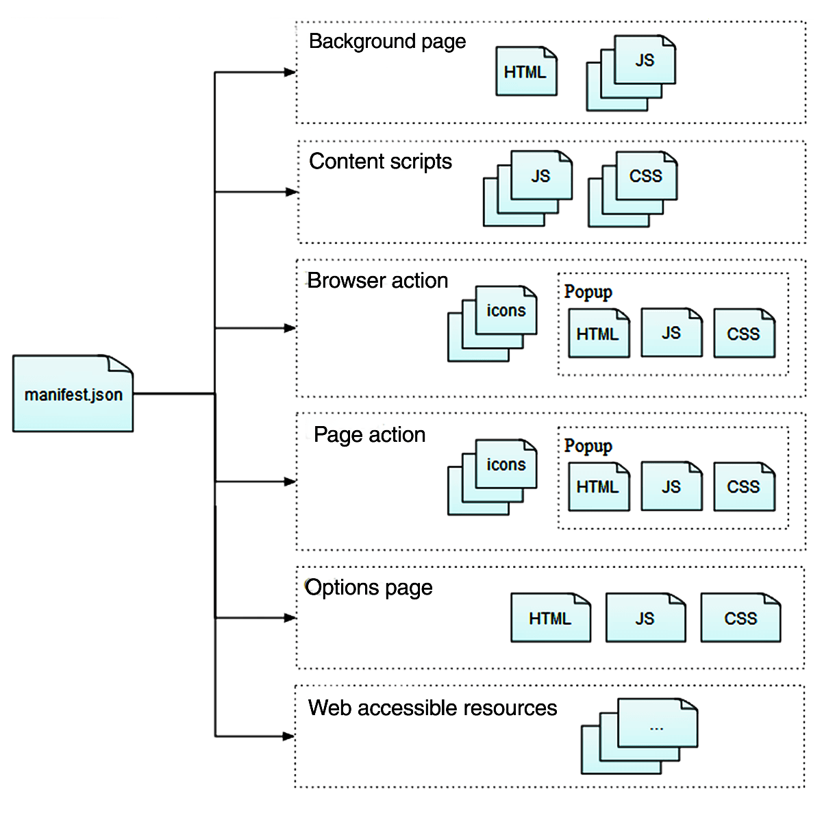
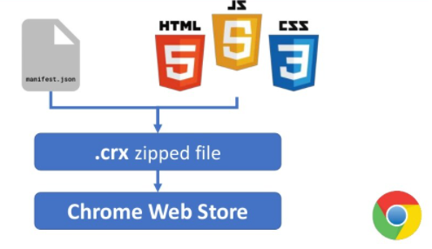
I. How to build a chrome extension?
Architecture

Slide 9
I. How to build a chrome extension?
Architecture
An extension's architecture will depend on its functionality, but many robust extensions will include multiple components:
Manifest
Background Script
UI Elements
Content Script
Options Page

Slide 10
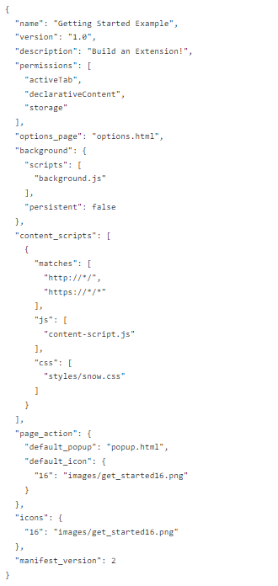
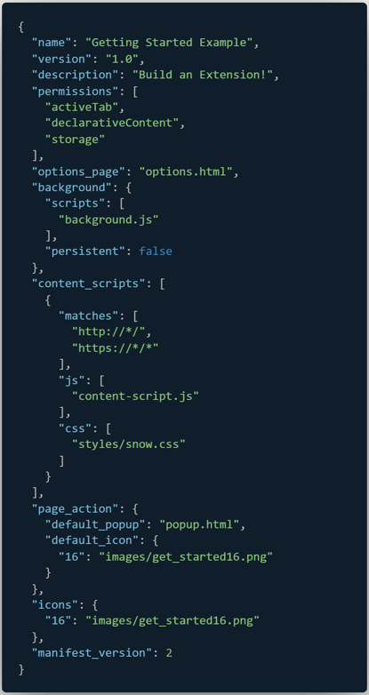

I. How to build a chrome extension?
Manifest.json
Description
Version
Name
Permissions
Browser_action
Content_scripts
Background
Icons
…

Slide 11
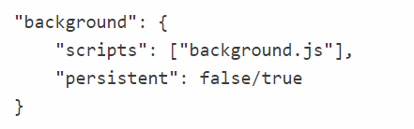
I. How to build a chrome extension?
Background script
The background script is the extension's event handler, load extensions
It contains listeners for browser events that are important to the extension.
It receives messages from content script or other extensions..
As you may have guessed, if the persistent property is false then you are using event pages. Otherwise, you are working with a persistent background page.

Slide 12
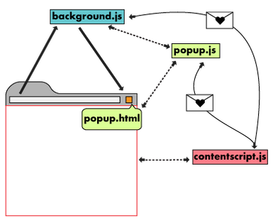
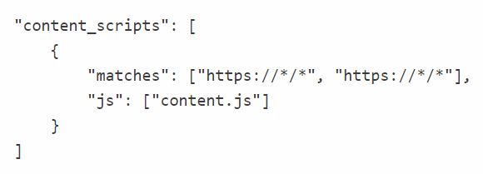
I. How to build a chrome extension?
Content script
Used to interact with content loaded into the browser.
JavaScript gets injected into pages.
Content scripts read and modify the DOM of web pages the browser visits

Slide 13
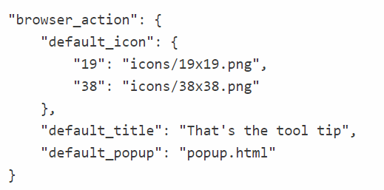
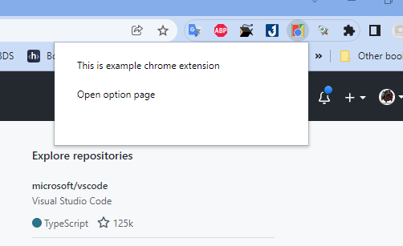
I. User Interface
Browser Action ( popup )

Slide 14
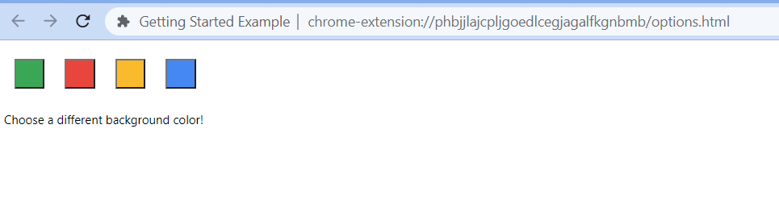
I. User Interface
Option page
Just as extensions allow users to customize the Chrome browser, the options page enables customization of the extension. Options can be used to enable features and allow users to choose what functionality is relevant to their needs.
"options_page": "options.html",

Slide 15
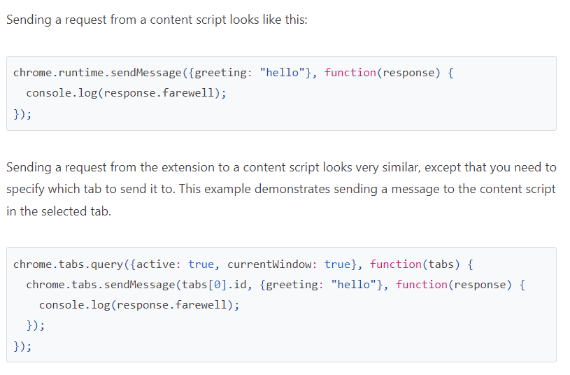
I. User Interface
Messaging

Slide 16
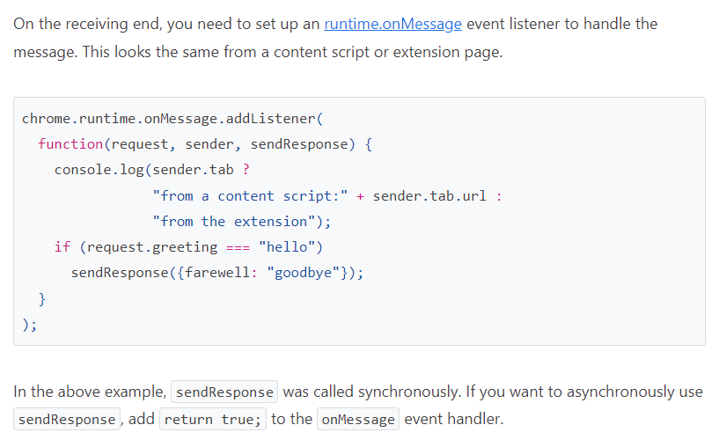
I. User Interface
Messaging

Slide 17
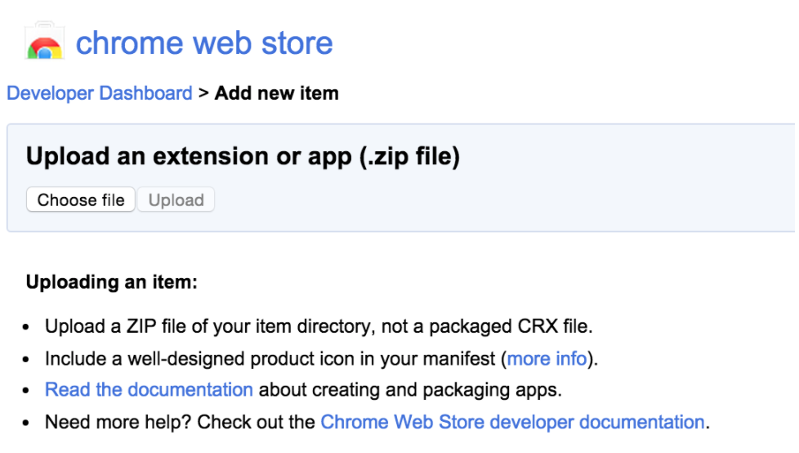
I. Publish Ext
Upload to store
https://chrome.google.com/webstore/developer/dashboard
Zip your code and prepare required information to upload your extension

Slide 18
I. Generate?
https://github.com/yeoman/generator-chrome-extension
http://extensionizr.com/
https://github.com/lxieyang/chrome-extension-boilerplate-react

Slide 19
I. Reference
https://developer.chrome.com/docs/extensions/mv3/messaging/
https://code.tutsplus.com/en/tutorials/developing-google-chrome-extensions--net-33076

Slide 20


I. Reference
Đánh rơi một chiếc cu-te để cuộc đời thơm ngon như phô mai que!!!

